Slide 1
Are MOOCS an Effective Replacement to Traditional Courses
Charles Samuel, Levi Sutton, Romelle Green

Slide 2
What are MOOCS?
Massive Open Online Courses (MOOCS) are online courses that allows anyone from anywhere to have access to higher education for free.
In 2012 many journalist and academics believe this new medium of acquiring higher education will either eventually replace the traditional institutions, or they will become a fierce competitor in the education market. People are drawn to the idea of giving high school graduates an opportunity to receive skills for a particular market without putting themselves in massive debt.

Slide 3
Advantages/Disadvantages of MOOCS
Advantages:
Courses are offered for free (in the early days)
Access to courses offered by professors at the top schools
Courses are available to a vast and diverse audience across the world
Learners’ performance can be monitored easily using the data captured during the start of courses
Can be used as a tool in a blended learning program, where students can access more information than what is provided in the class
Disadvantages:
Can’t provide for personalized courseware and attention from a tutor
Difficult to keep track of students’ assignments and involvement
Learners with disabilities and a poor Internet connection can’t use MOOCs
Language can be a barrier while offering MOOCs
MOOCs can’t be used as a credit-earning course at universities (Generally true)

Slide 4
Advantages/Disadvantages of Traditional Classrooms
Advantages:
Beneficial for learning, because students can interact with teachers and classmates.
The learning atmosphere of the traditional classroom help students stay focused and motivated.
Accessible: Not all students have access to technological devices, so online classes are not an option.
Provides students with a fixed schedule and specific periods dedicated exclusively to learning
Disadvantages:
Traditional education is cost demanding. Tuition fees are usually very high. Also the textbooks or other school supplies that are required can be expensive as well.
No Flexibility: Students have to shape their personal schedules to accommodate their school schedules.
Generalized education keeps students from learning the things they are interested in
In traditional classrooms, teachers and books are the only source of information

Slide 5
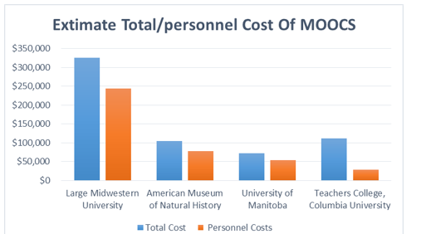
Average Cost of MOOCS
Midwestern: Total - $325,330
Personel - $244,000
American Museum: Total - $104,620
Personel - $78,470
Manitoba : Total - $71,800
Personel - $53,800
Columbia : Total - $110,950
Personel - $29,238

Slide 6
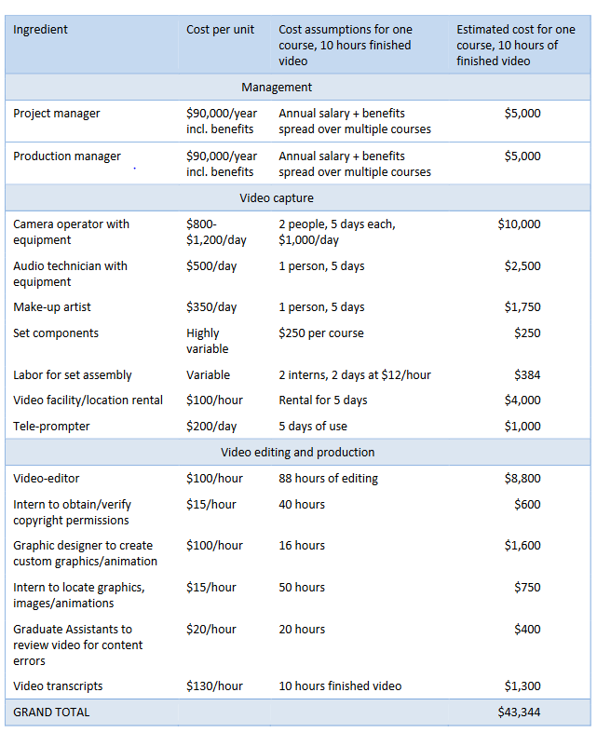
This chart displays the estimate cost of
10 hours worth of video for one course.
The total cost is $43,344

Slide 7
Team Effort
Developing a MOOC is a team effort. This requires an enlistment of different individuals from various fields that typically includes:
Programmers Project managers
Videographers Administrators
Instructional technologist Faculty members
Instructional designers Teaching assistants

Slide 8
Business Model
I will only focus on three MOOC providers: Coursera, Udacity, and Edx.
Their beginnings.
The MOOC was launched by a few professors from ivy league schools.
The creators wanted to expand access to education to anyone anywhere for free.
All course materials were free to access. Users that completed a course received a certificate free of charge.

Slide 9
Coursera’s business model
Users will have to pay a fee to receive a certificate.
New course material is behind a paywall (old courses are free).
Release courses with high monetarily gains.
Specialization - a sequence of online courses designed to enable you to master a particular topic
Specialization Monthly subscription ($39 to $89) / 7 day free trial.

Slide 10
Edx’s business model
User must pay a fee for certificates.
Professional Certificate / X-series (similar to Coursera’s Specialization).
MicroMasters - grants credit toward a master degree if the user is currently enrolled in the universities program.
Professional Education - courses behind a paywall.
Currently developing new business models (support fee model).

Slide 11
Udacity’s business model
Certificates are behind a paywall.
NanoDegress: teach users basic programing skills that could land them an entry level position at companies like AT&T (Georgia Tech, AT&T).
Can pay monthly fee to access material in NanoDegress.

Slide 12
MOOC COMPLETION RATES
As many as 4,180 available
January 2016
Average completion rate - 15%
Udacity’s completion rates below 8% in November of 2013
University of Pennsylvania School of Education Study - Conducted a study of over 1,000,000 students through 16 of their courses offered through coursera
4% completion rate

Slide 13
INDIVIDUAL MOOC COMPLETION RATES
Individual MOOC completion rates are higher than the average MOOC completion rate
Platzi courses averaged a 70% completion rate
Caused other MOOC platforms to aim for higher completion rates
Udacity (after reshuffling the structure of some courses) was able to get completion rates up to 87%
System has much potential
Prices for these courses are higher
Individual MOOCS aimed at teaching a specific group of people about a specific topic normally fall under this category
Ex. Tenaris University - first course titled “Thermodynamical Processing of Metals”
90% completion rate

Slide 14
ACTIVATION RATES
Many users who enroll in courses never actually start them
50% drop out after the course’s first week
The further into the course, the more likely to complete
This data may be misrepresentative of mooc completion rates

Slide 15
Current state of MOOCS
MOOC providers are becoming more concerned with making profits.
Some providers are only releasing courses with high monetarily gains.
MOOCS have a low completion rate.
Some MOOC providers have lost faith in MOOCS.
Udacity: Sebastian (founder) “Worthless product”.
Clarissa Shen (VP) “MOOCS are dead”.
Conclusion: We believe MOOCS could complement traditional colleges.

